Slide 1
Opening grocer’s shop in NYC

Slide 2
NYC Background
New York City (NYC) is the most populous city in the United States.
Estimated 2019 population of 8,336,817 distributed over about 302.6 square miles (784 km2) makes NYC the most densely populated major city in the United States.
New York City is composed of five boroughs: Brooklyn, Queens, Manhattan, the Bronx, and Staten Island.

Slide 3
Our Target
Find opportunities to open new grocery shop in NYC
Absence of grocery stores in area
Low criminal

Slide 4
Data Description
Requirements
NYC neighborhoods
List of venues
Official crime information for NYC
Sources
Foursquare API
NYC Neighborhhods (https://opendata.cityofnewyork.us/)
Crime dataset (https://data.cityofnewyork.us)

Slide 5
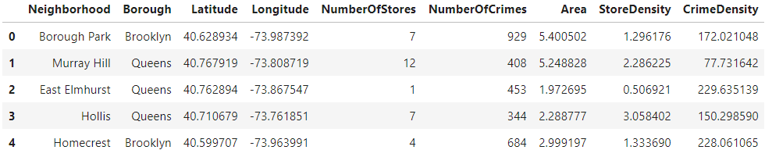
Cleaned Data

Slide 6
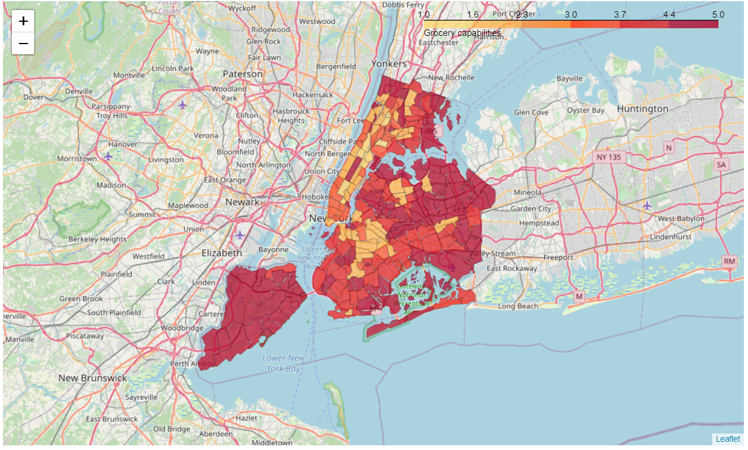
Map of Opportunities

Slide 7
Conclusion and future directions
The results may be interesting for investors who are going to create a new business in NYC
Discovered useful information about grocery opportunities in NYC
Visualized and easy to use results
Future steps should contain more precise and smaller areas investigations

